Slide 1

Game Simulation data analysis
Capstone project for Emmanuel Duarte
Based off gameplay simulations developed by Chris Moscoso
Jan. 2023
Notes:
Mention The Name of the game,
Chris’s excitement and many years of work

Slide 2
agenda
Introduction
Hypothesis
Game Rules
Question Answered/Code Used/Charts & Graphs
Summary

Slide 3
Introduction
In search of a meaningful data-based capstone project, I reached out to several developer friends to see if they had any suggestions. One such friend relayed his excitement over a pirate themed digital card game he was developing which he was in the process of play testing. He finished the backend work and developed a simple AI to run through thousands of simulations to see if there was anything that was disbalanced or overpowered. He got the data in JSON format and tasked me with several questions that could help him make gameplay with users more fun and run more smoothly. Throughout the course of this presentation, I will attempt to show the process of how these questions were answered and the tools utilized to make them possible.

Slide 4
Hypothesis
In consideration of the fact that this is not a dataset from a company that is dedicated to extracting data, I am aware that some of the data may be difficult through parse through and analyze. From my current understanding of the programs I’ll be using (R Studio/Python Pandas), and the large amounts of variables in the dataset I’ve looked through I have the idea that working with the data for numerical values or making quick data-frames is going to be easier in Python, but showing the data in graphs will be simplified, by R. I am excited to learn different techniques to analyze these complicated data-frames.

Slide 5
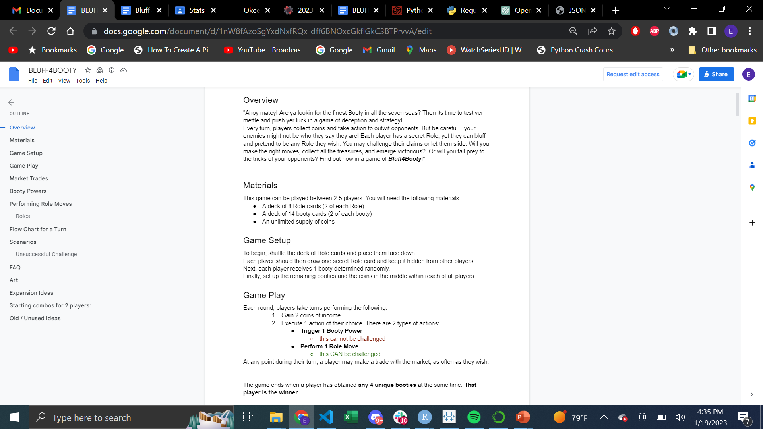
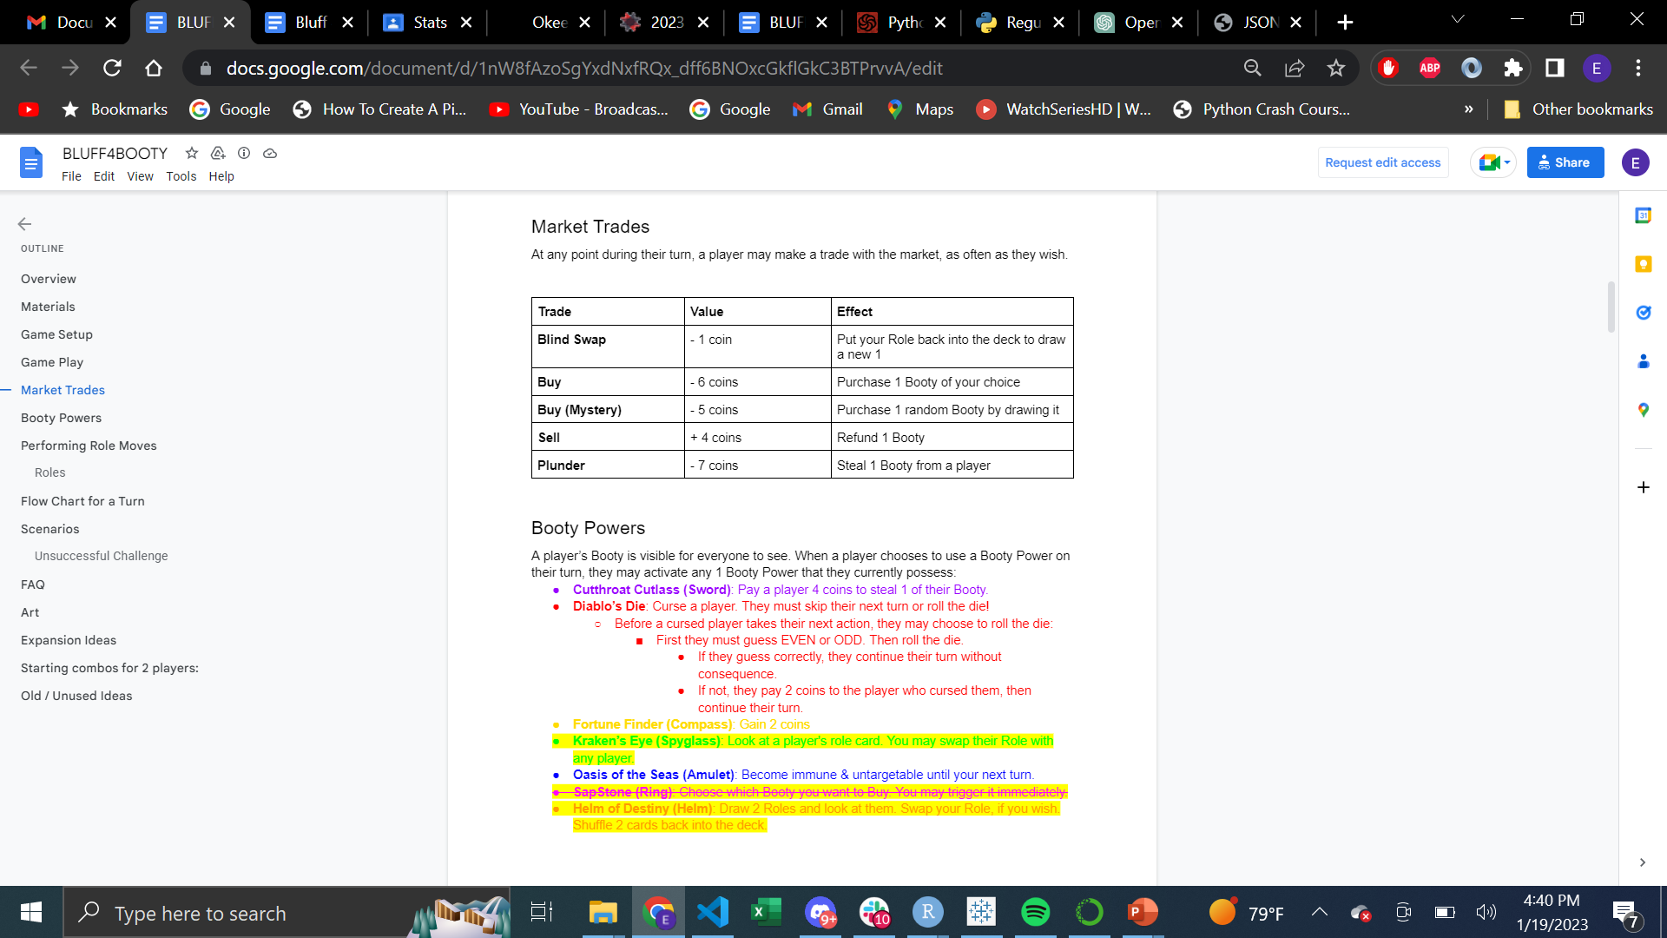
Game rules

Slide 6
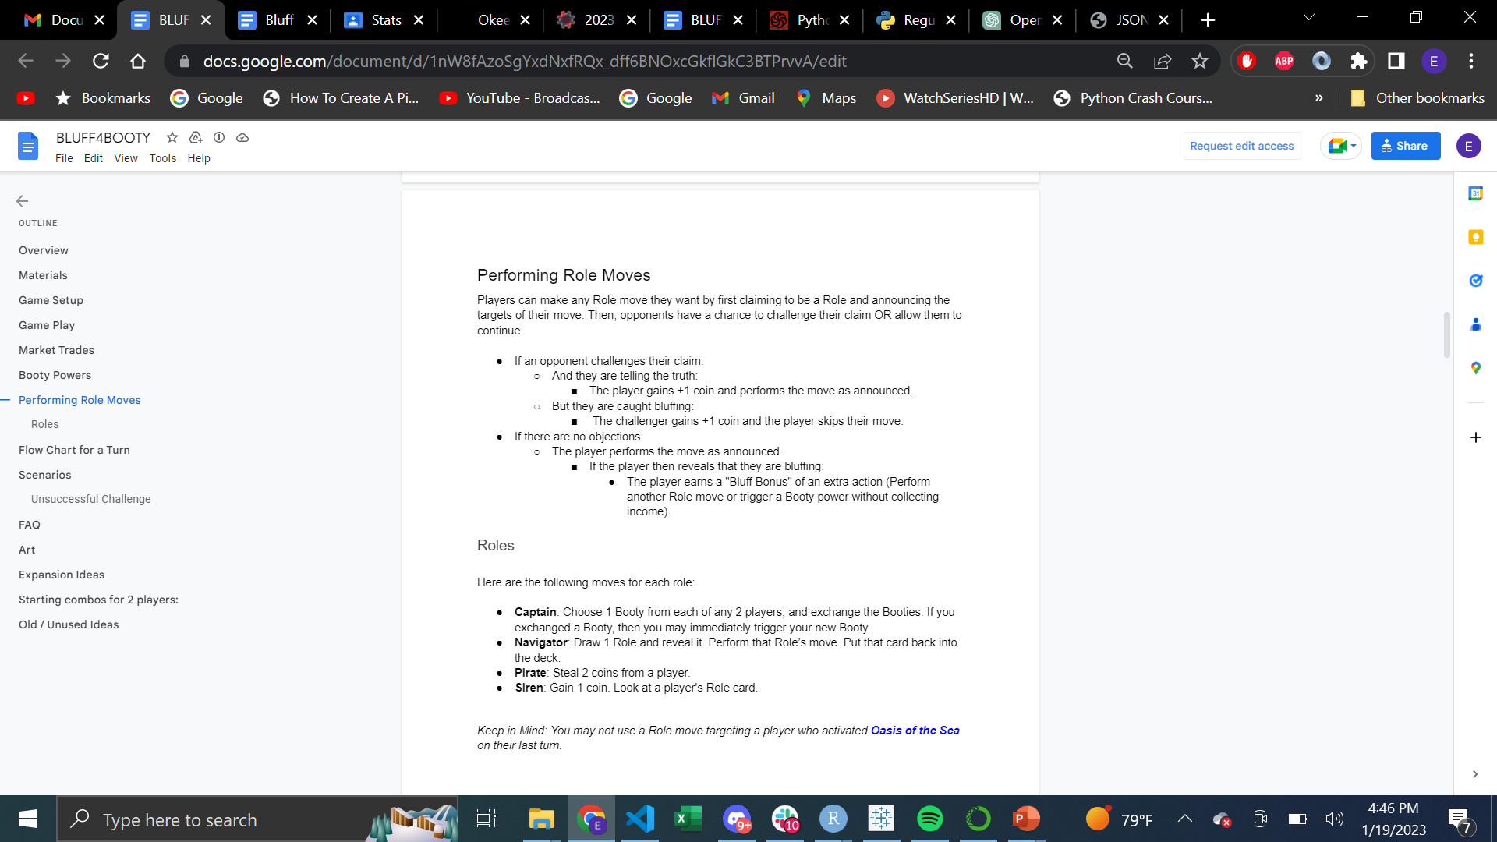
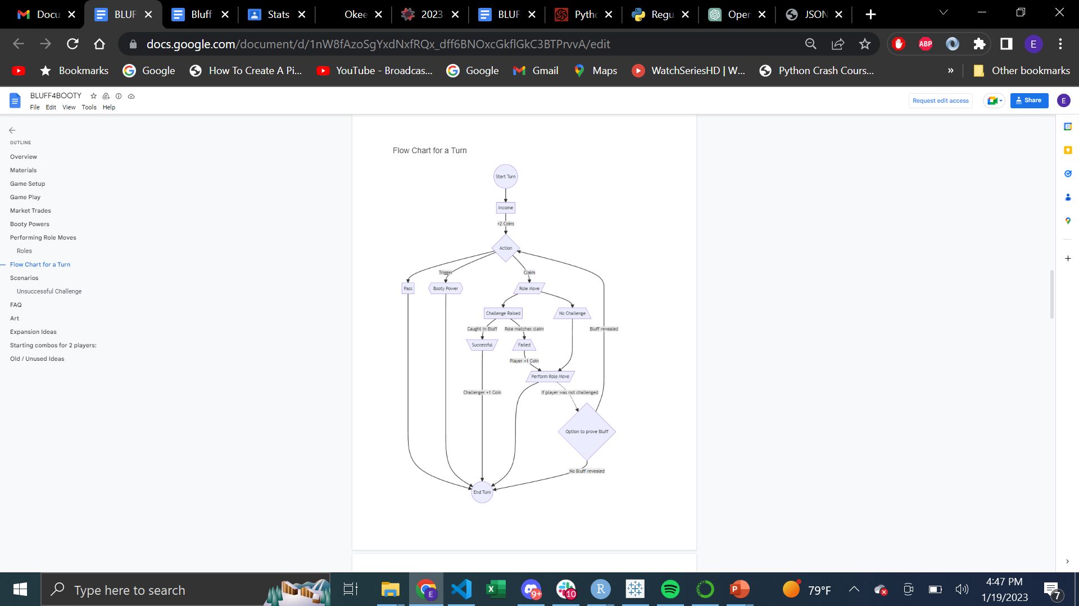
Game rules

Slide 7
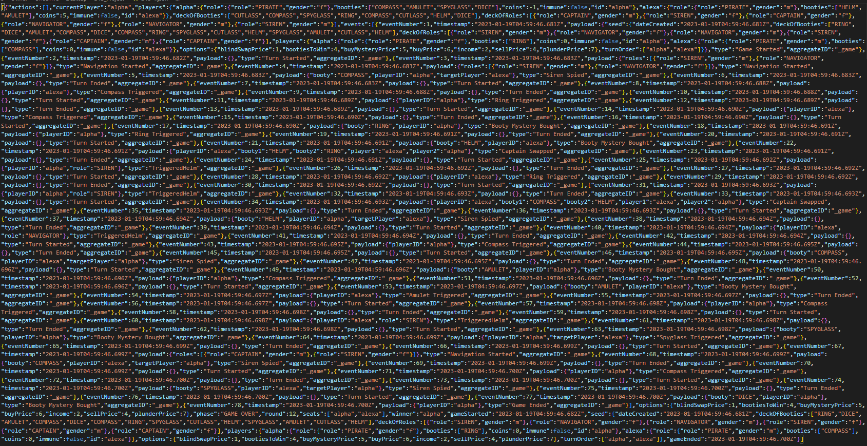
JSON text for a SINGLE game simulation

Slide 8
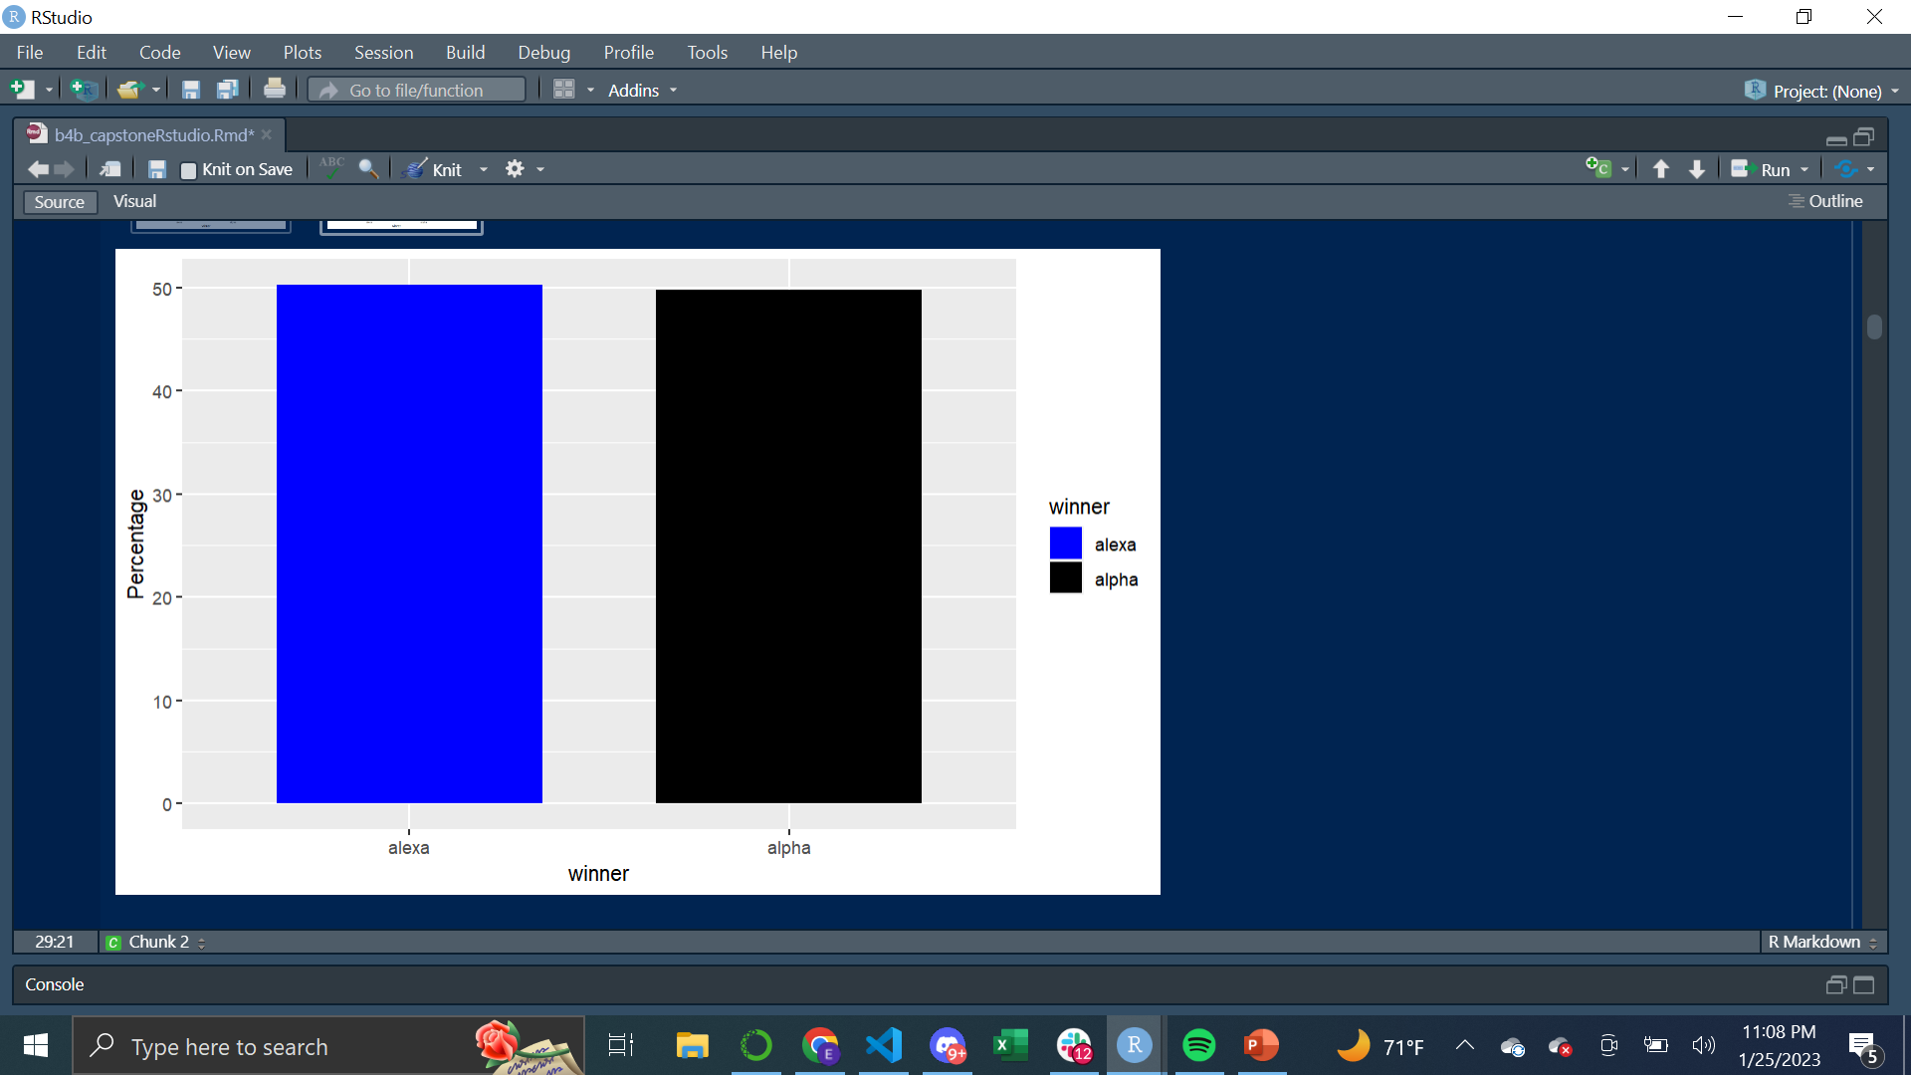
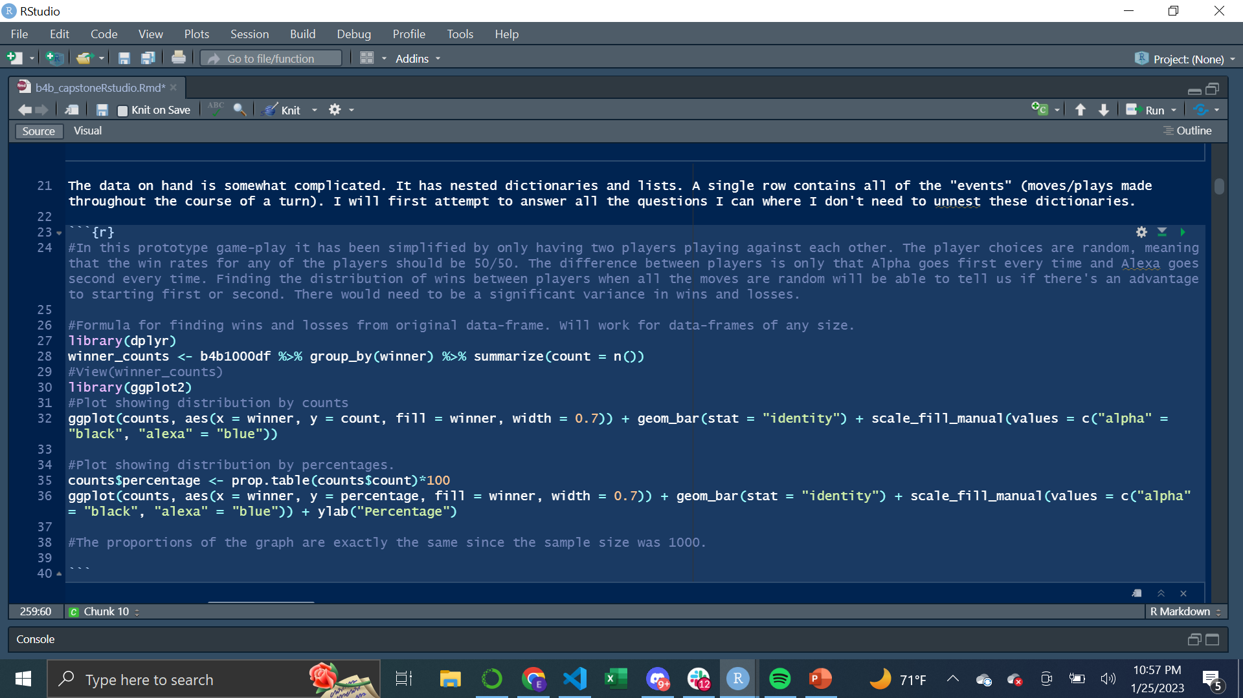
Question Answered/Code Used/ Charts & Graphs
In order to understand the data I decided to answer the easier questions first. I notice that the data on hand is complicated. It has nested dictionaries and lists. A single cell contains all the "events" (moves/plays made throughout the course of a turn for an entire game).
I first attempted to answer all the questions I could where I didn’t need to unnest these dictionaries.
In this prototype game-play it has been simplified by only having two players playing against each other. The player choices are random, meaning that the win rates for any of the players should be 50/50. The difference between players is only that Alpha goes first every time and Alexa goes second every time. Finding the distribution of wins between players when all the moves are random will be able to tell us if there's an advantage to starting first or second. There would need to be a significant variance in wins and losses.
In this result the percentage wins between Alpha and Alexa were almost exactly even giving no advantage to going first.

Slide 9
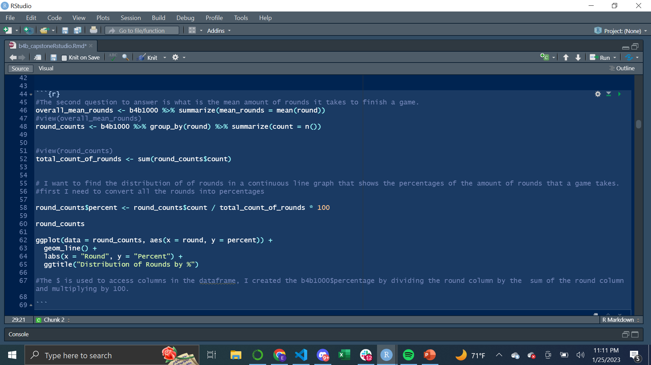
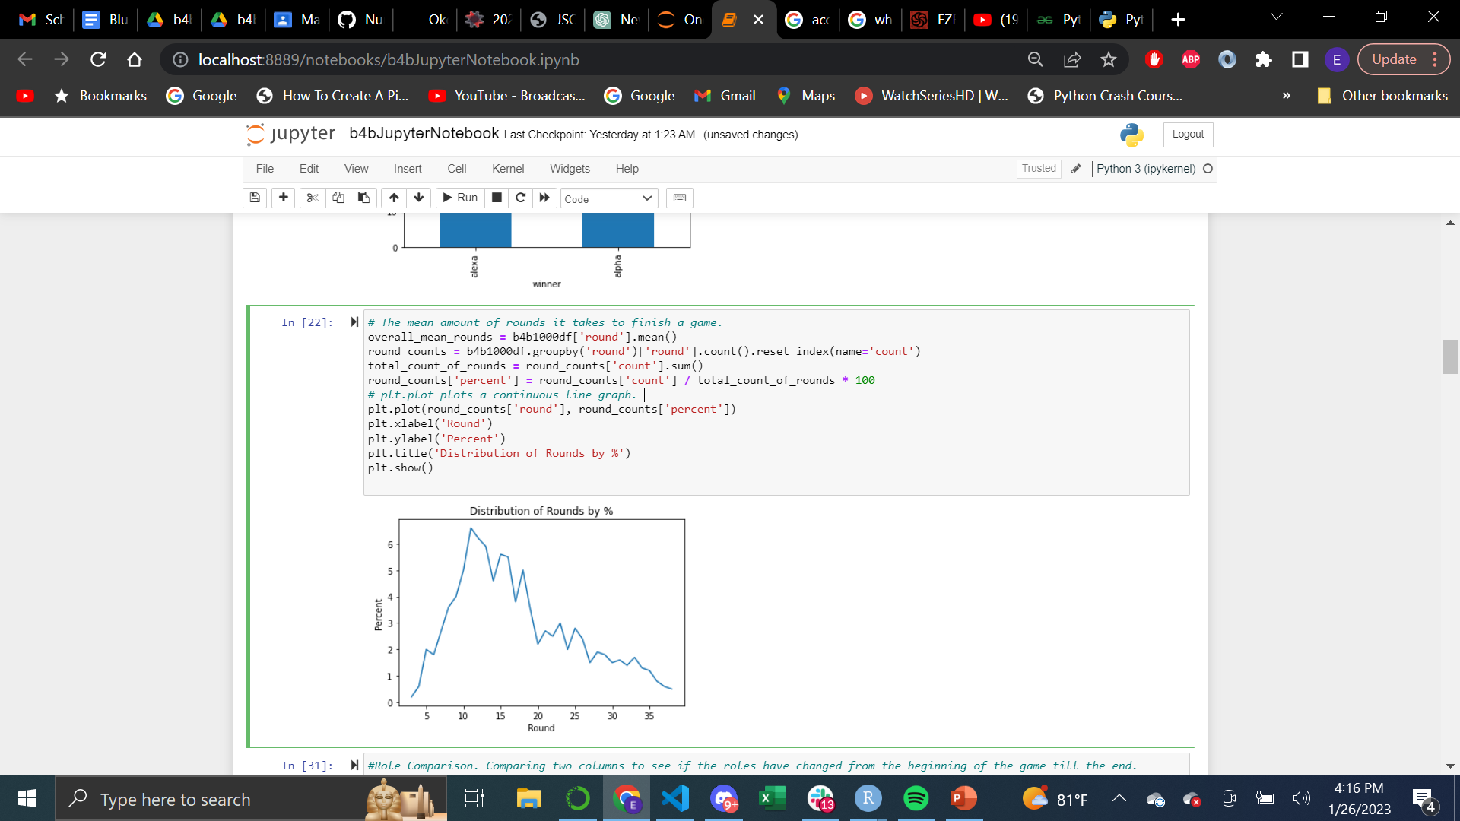
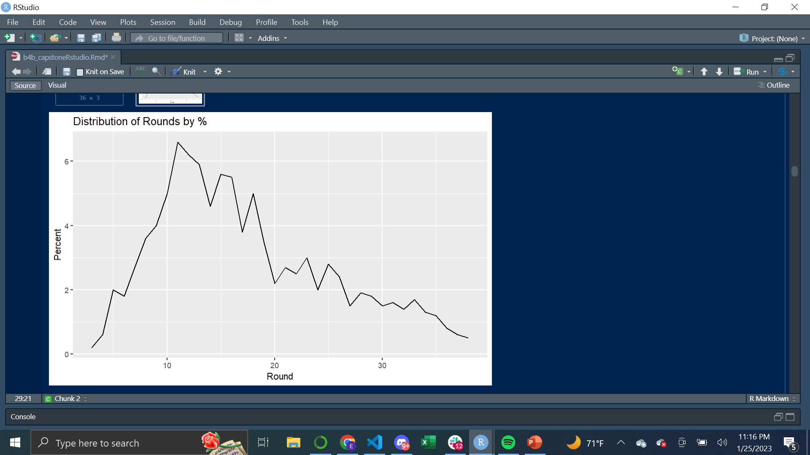
R Code Used
Question Answered/Code Used/Charts & Graphs
The next question was to find out what round the game ends on average.
Simply needed to find the mean of the round column, find the percent and plot it using the goem_line function in ggplot2 and matplotlib
In pandas, I found the count of how many games ended in what round. I turned that into a continuous line graph using the plt.plot() function in matplotlib.
Python Pandas Code Used

Slide 10
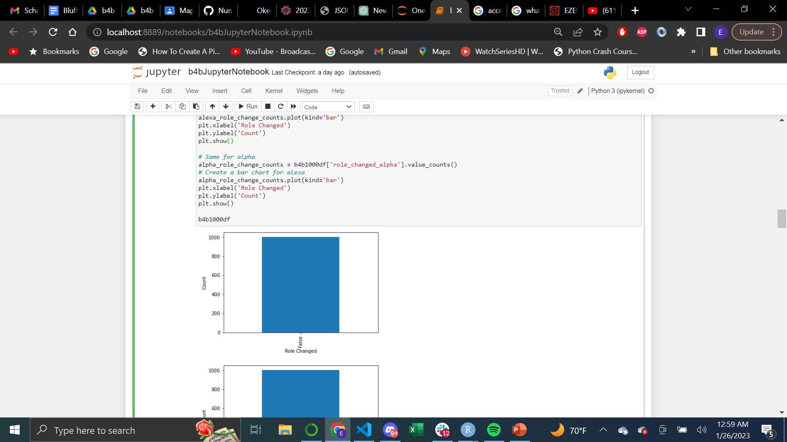
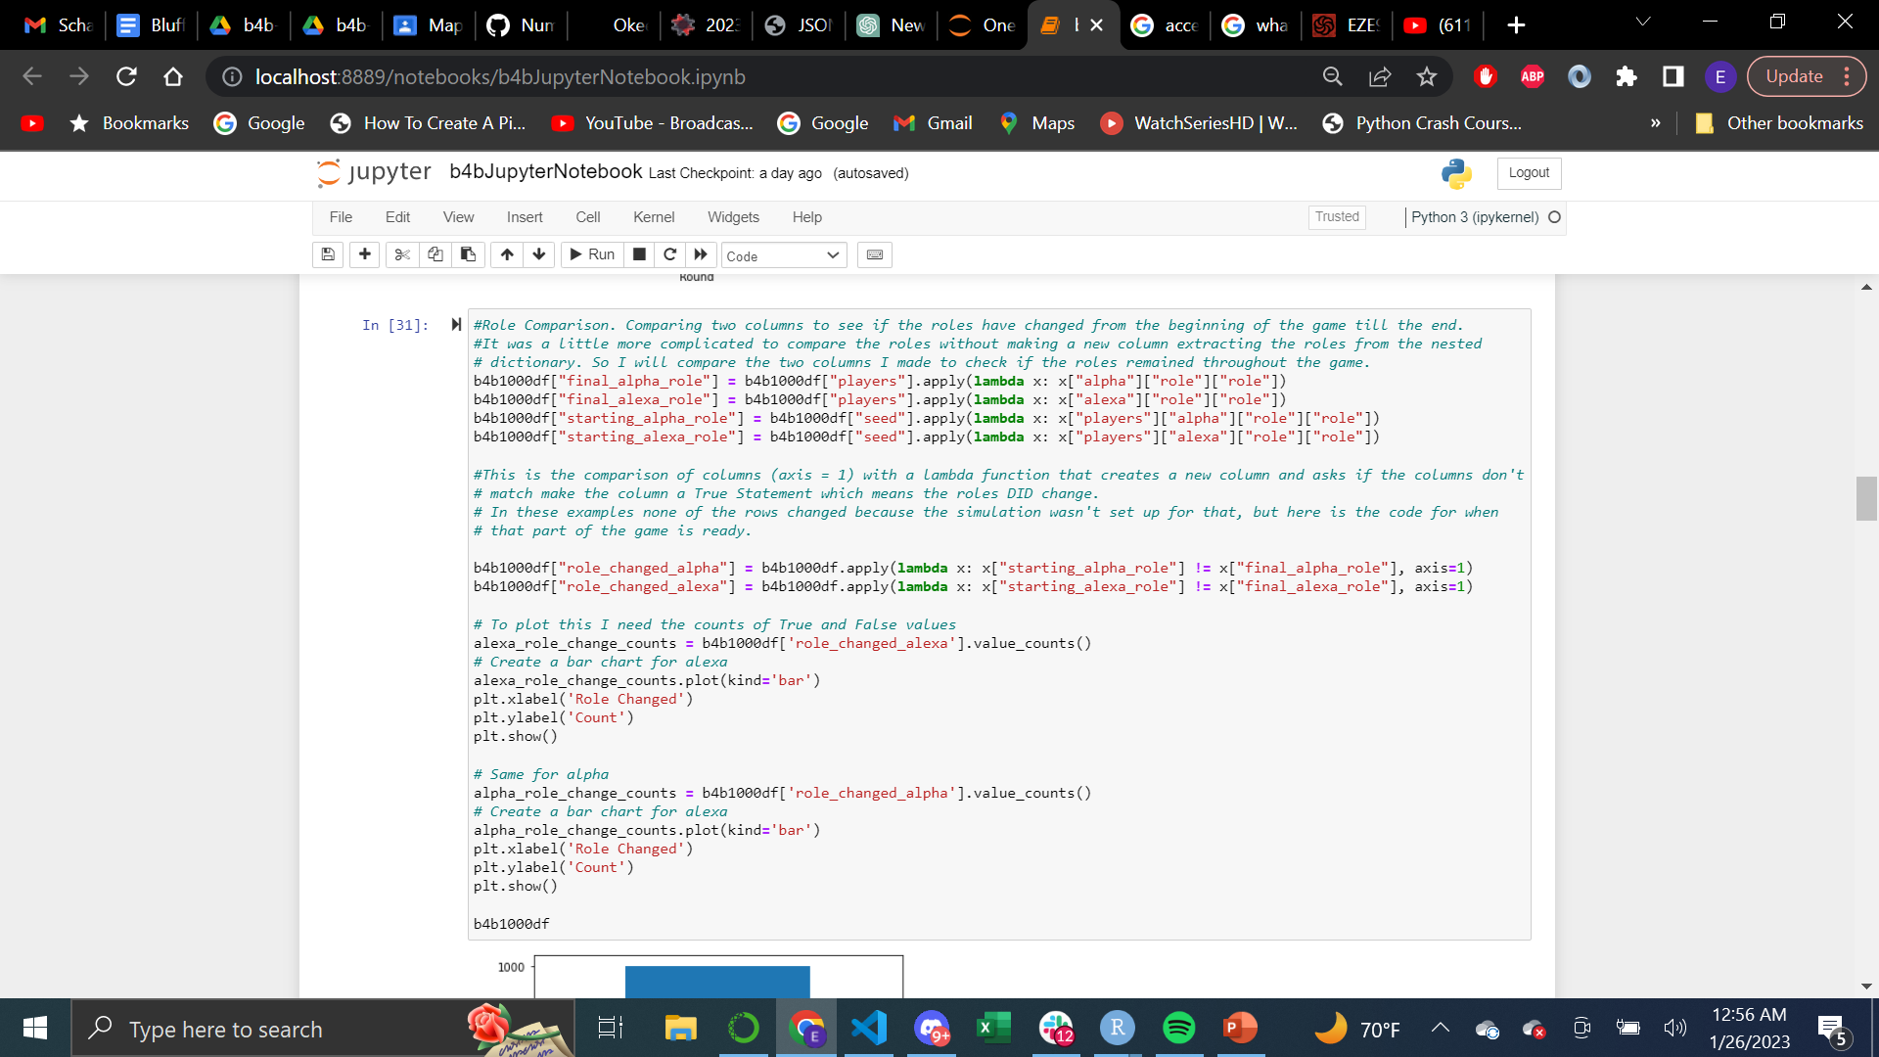
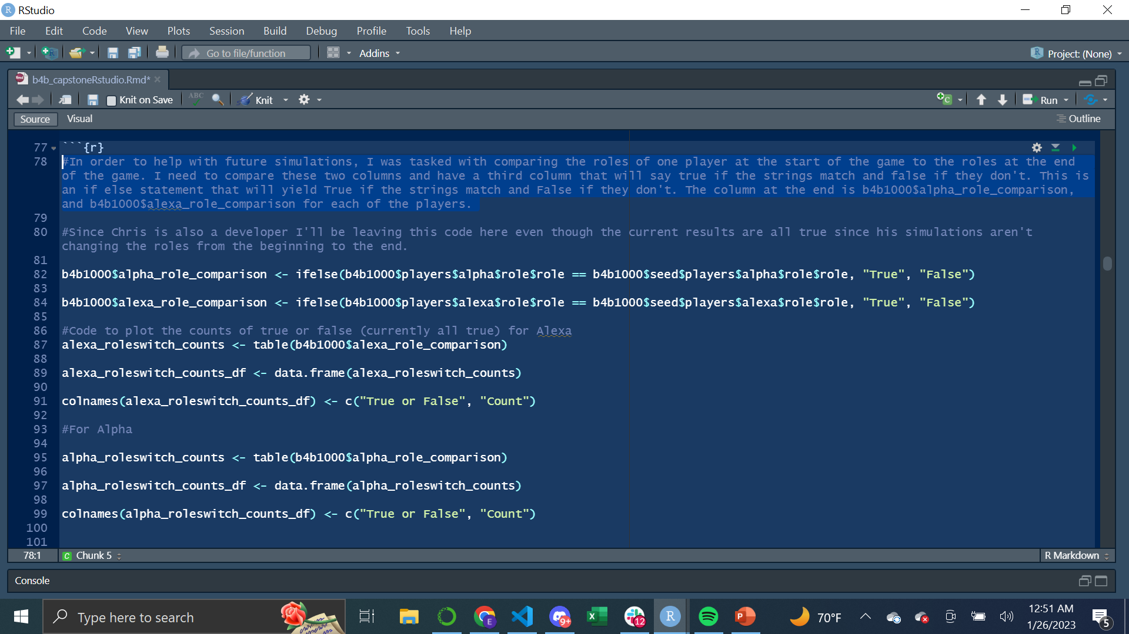
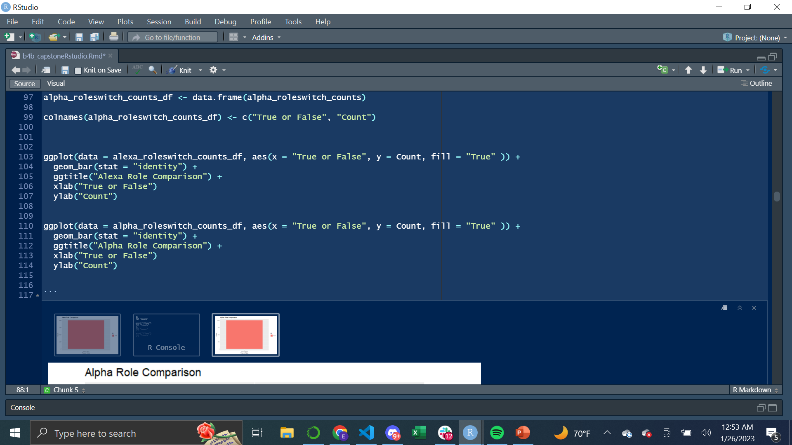
Question Answered/Code Used/Charts & Graphs
In order to help with future simulations, I was tasked with comparing the roles of one player at the start of the game to the roles at the end of the game. I need to compare these two columns and have a third column that will say true if the strings match and false if they don’t.
This is an if else statement that will yield False if the strings match and True if they don’t.
The simulation had bug and none of the players switched roles, but the code will work when the simulation is updated.
Python Pandas Code Used
R Code Used

Slide 11
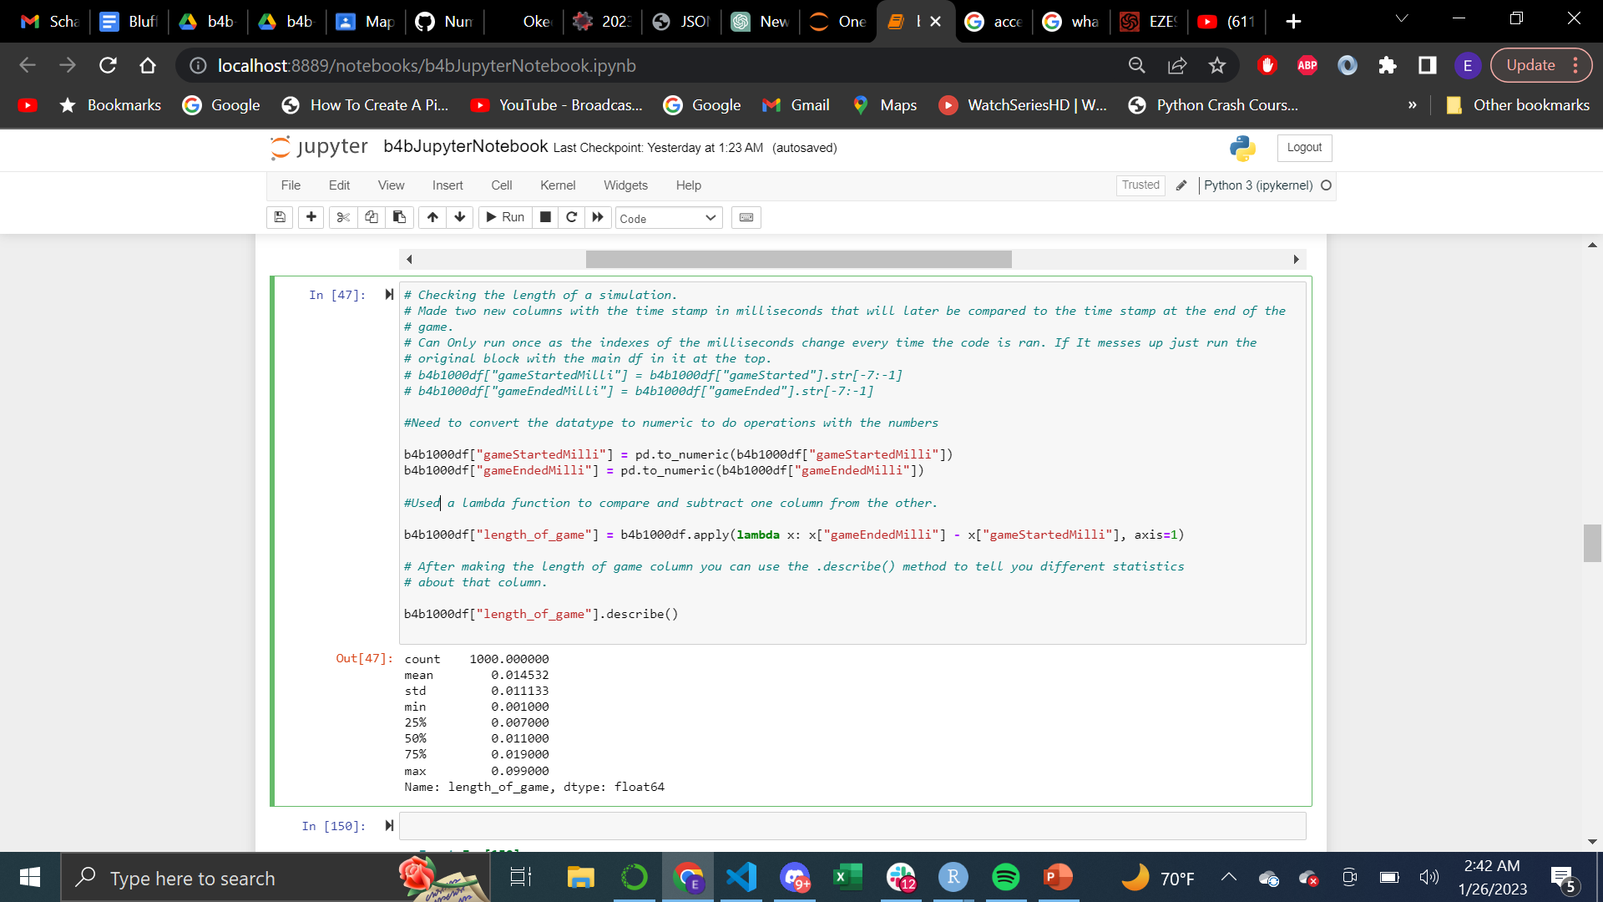
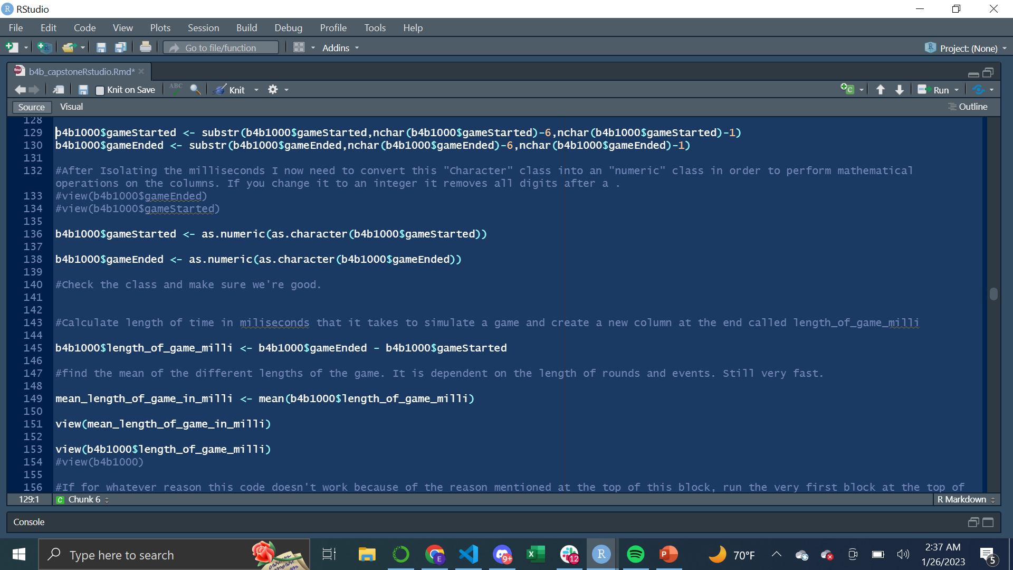
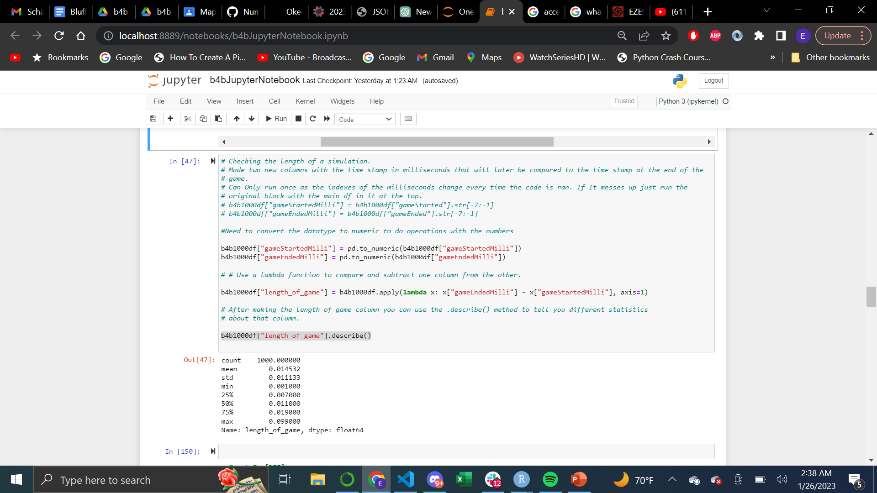
Question Answered/Code Used/Charts & Graphs
On average how long does it take to simulate a game?
Looking for the difference between a game start and a game end. This is not as simple as it sounds since the format of these time stamps are as such "2023-01-19T05:06:02.384Z“ in a string format where the only part I'm interested in is 02.384. A game simulation only takes a fraction of a second.
I needed to isolate a segment of the timestamp and convert to a numeric value before processing.
Used .describe() method in pandas to get various stats from the different length of games.
R Code Used
Python Pandas Code Used

Slide 12
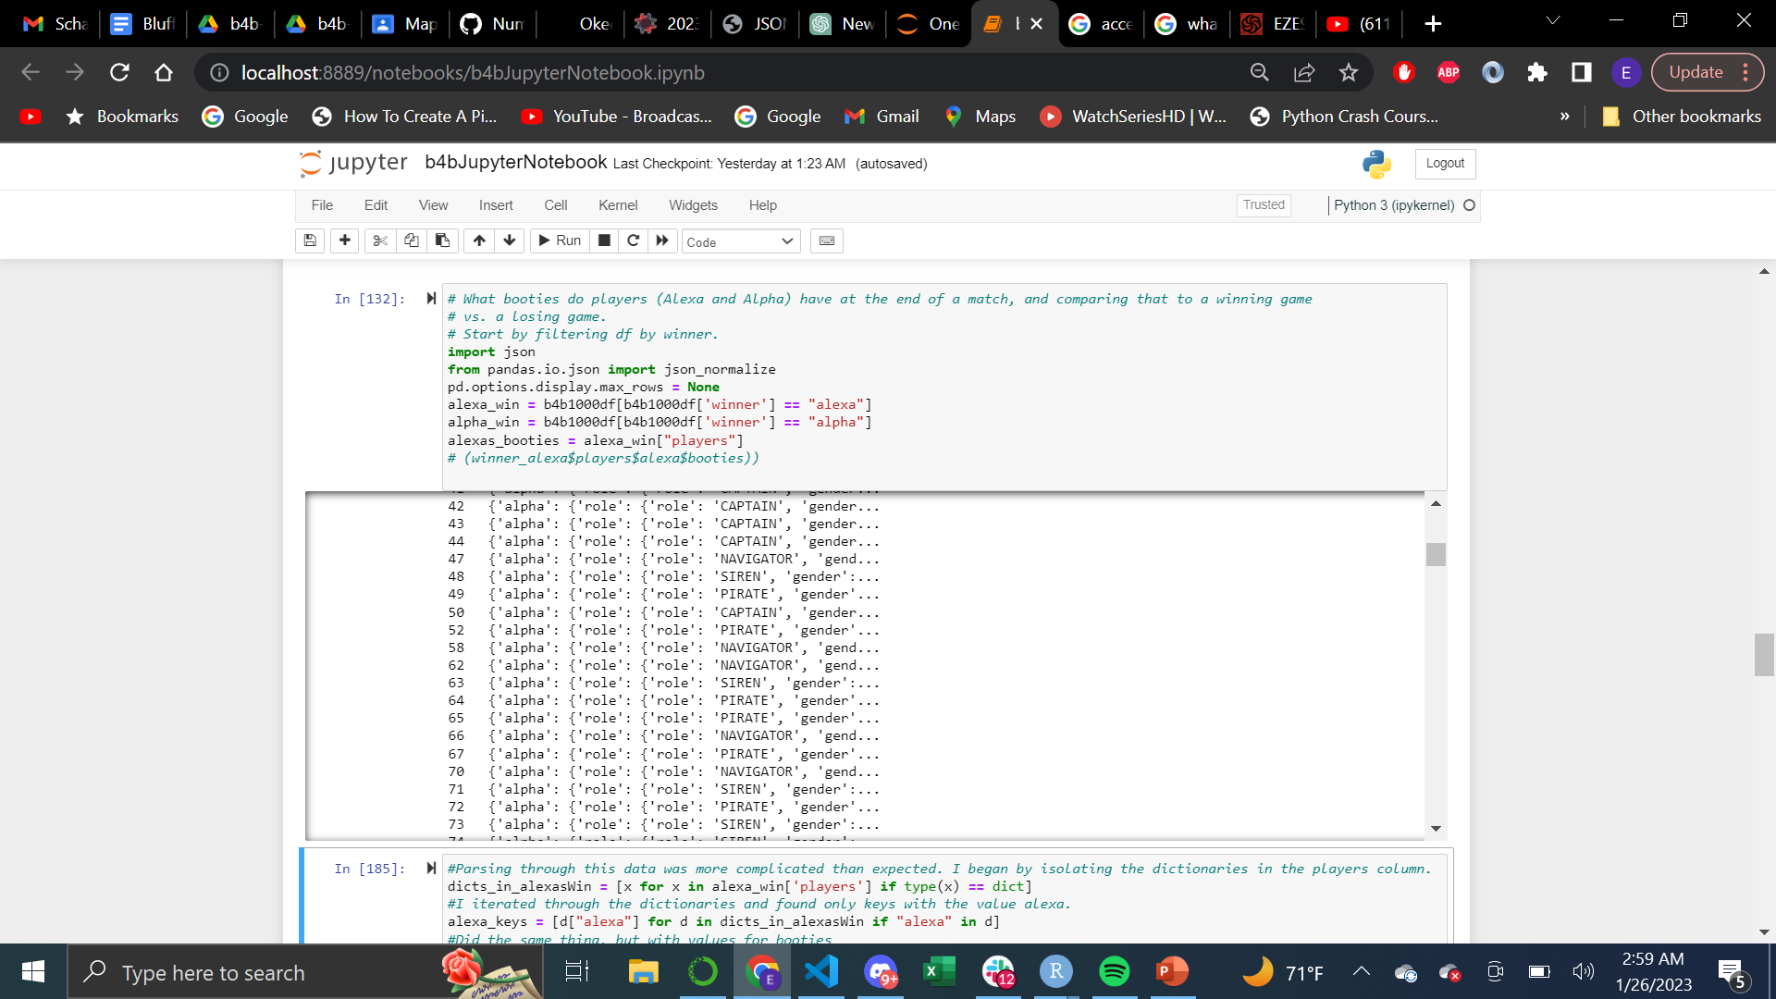
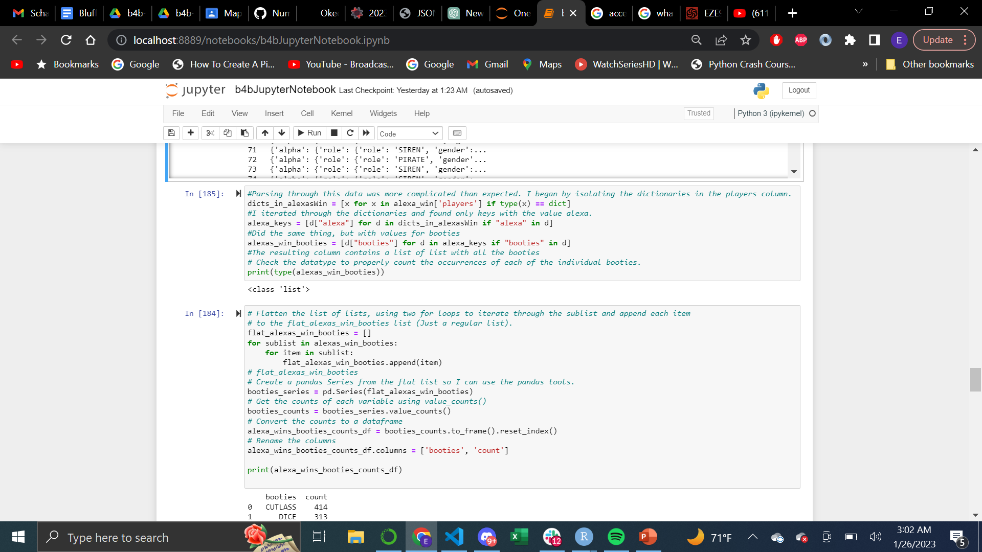
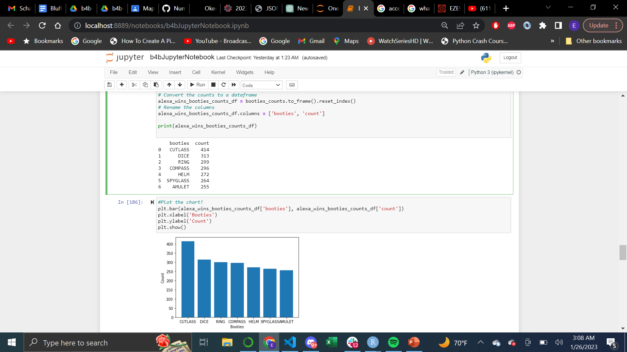
Question Answered/Code Used/Charts&Graphs
What booties do players (Alexa and Alpha) have at the end of a match? Compare that to a winning game vs. a losing game.
Is there a booty that contributes to wins more than losses?
This question required the unnesting of various lists and dictionaries inside of lists.
I tried my best to explain this in the comments of the code.
I don’t know of a simpler way to have done this, but I learned a lot about how JSON files hold data through finding this specific data in this giant nested data-frame.
Python Pandas Code Used
Python Matplotlib Code Used
<- Output
Output ->
Notes:
The objective of the game is to acquire 4 booties.
I wanted to get a booty count for the winners and compare them to the losers to see if there’s a power that is overpowered
I wanted to separate them by what player won for more valuable and reuseable code
Separated df by wins of different characters, and then looking directly at the players column I needed to go 4 layers deep into a dictionary to extract the information.
I needed to flatten the nested list to get a proper count of the booties. I Unnested the powers and put them in a separate list.
From there I was able to apply the pandas tools to get an analysis of the powers

Slide 13
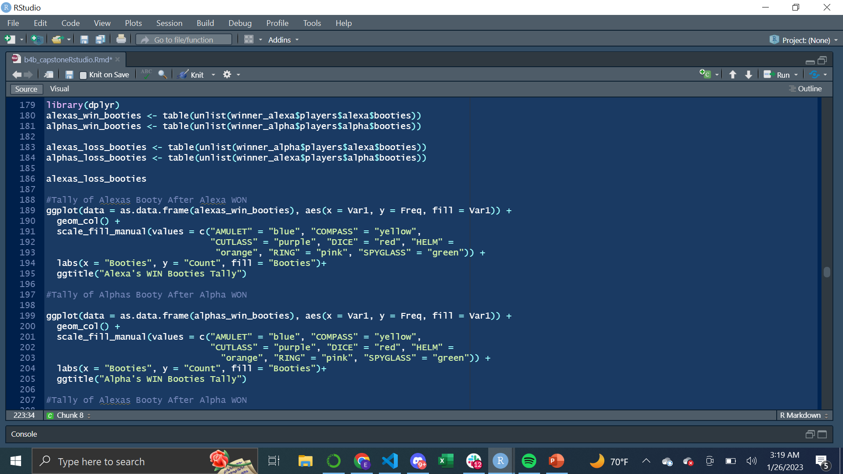
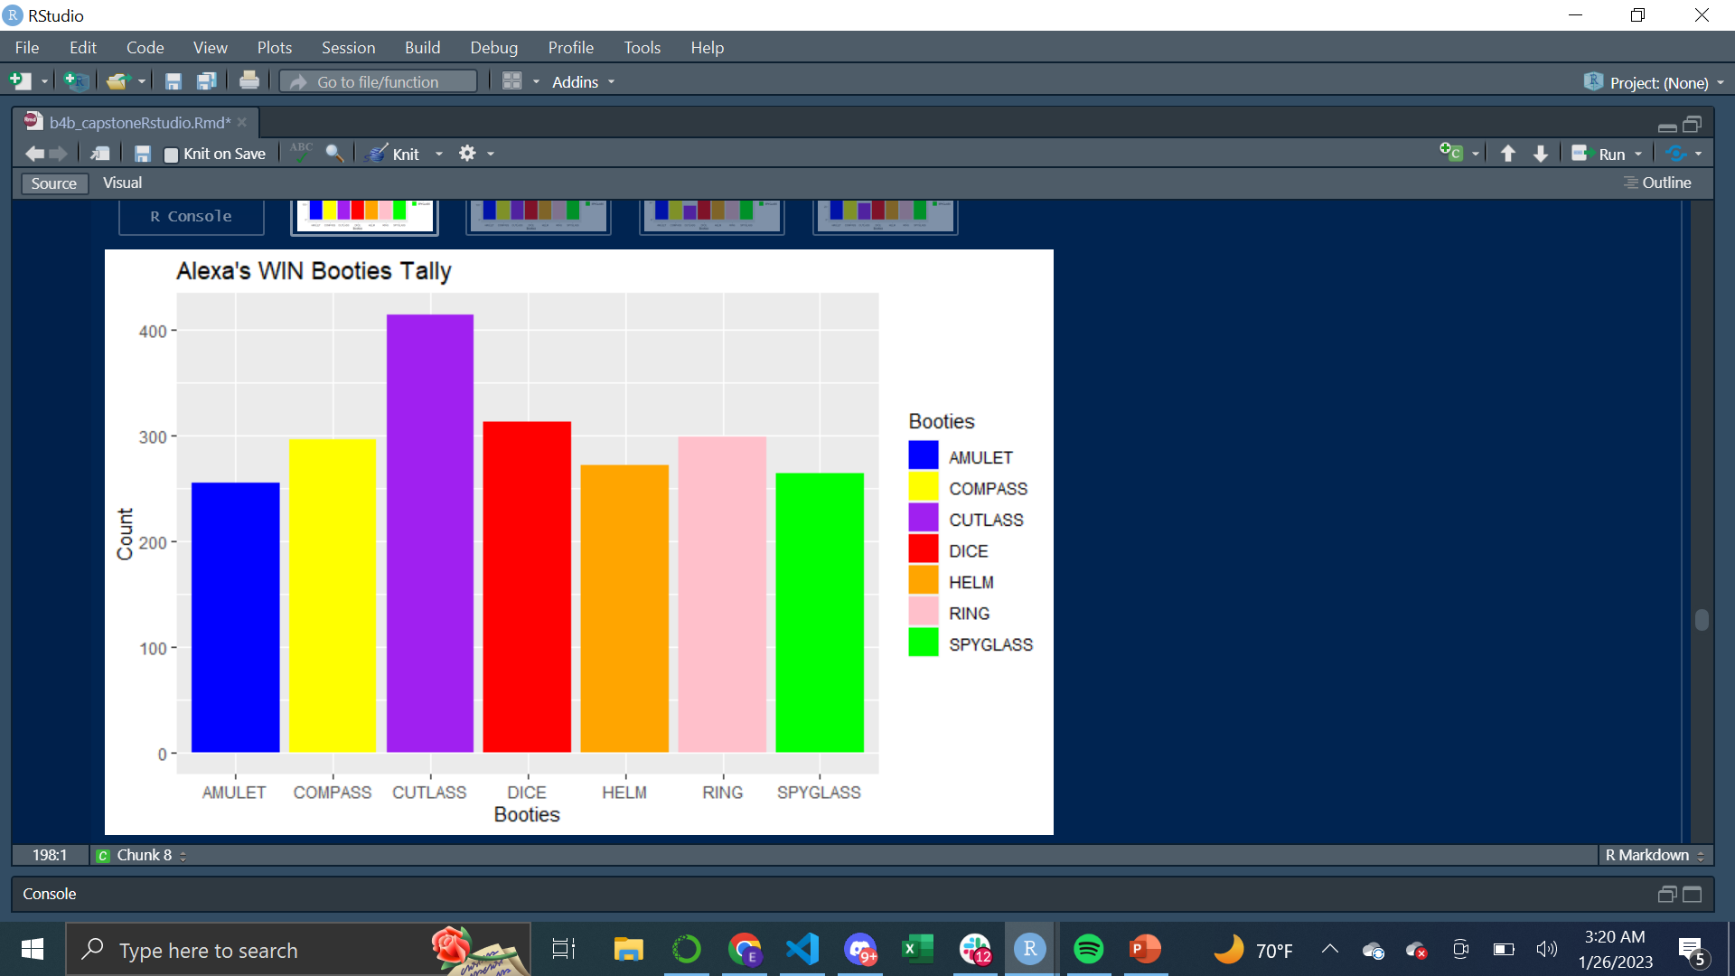
Question Answered/Code Used/Charts&Graphs
What booties do players (Alexa and Alpha) have at the end of a match, and comparing that to a winning game vs. a losing game.
Is there a booty that contributes to wins more than losses?
The answer to this question felt better represented in Rstudio where ggplot2 allows for simpler formatting of charts and color coding of bars. It was also much easier to unnest the dictionaries from the lists from an R data-frame. NO FOR LOOPS REQUIRED!
I made this same chart for Alexa/Alpha’s wins and losses.
R Studio Code Used
<- Output

Slide 14
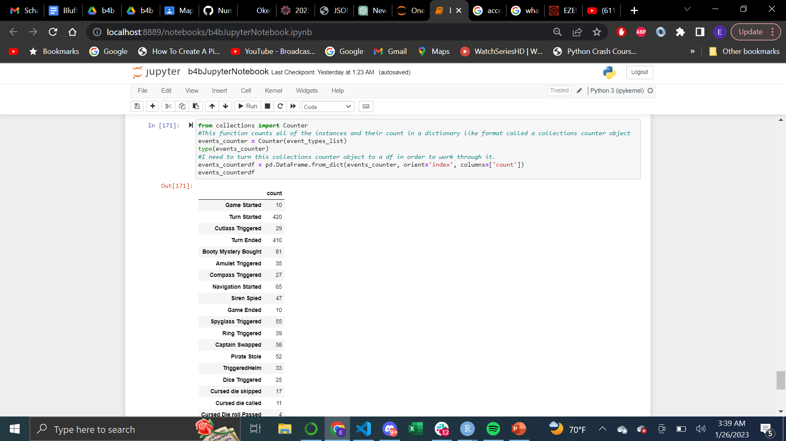
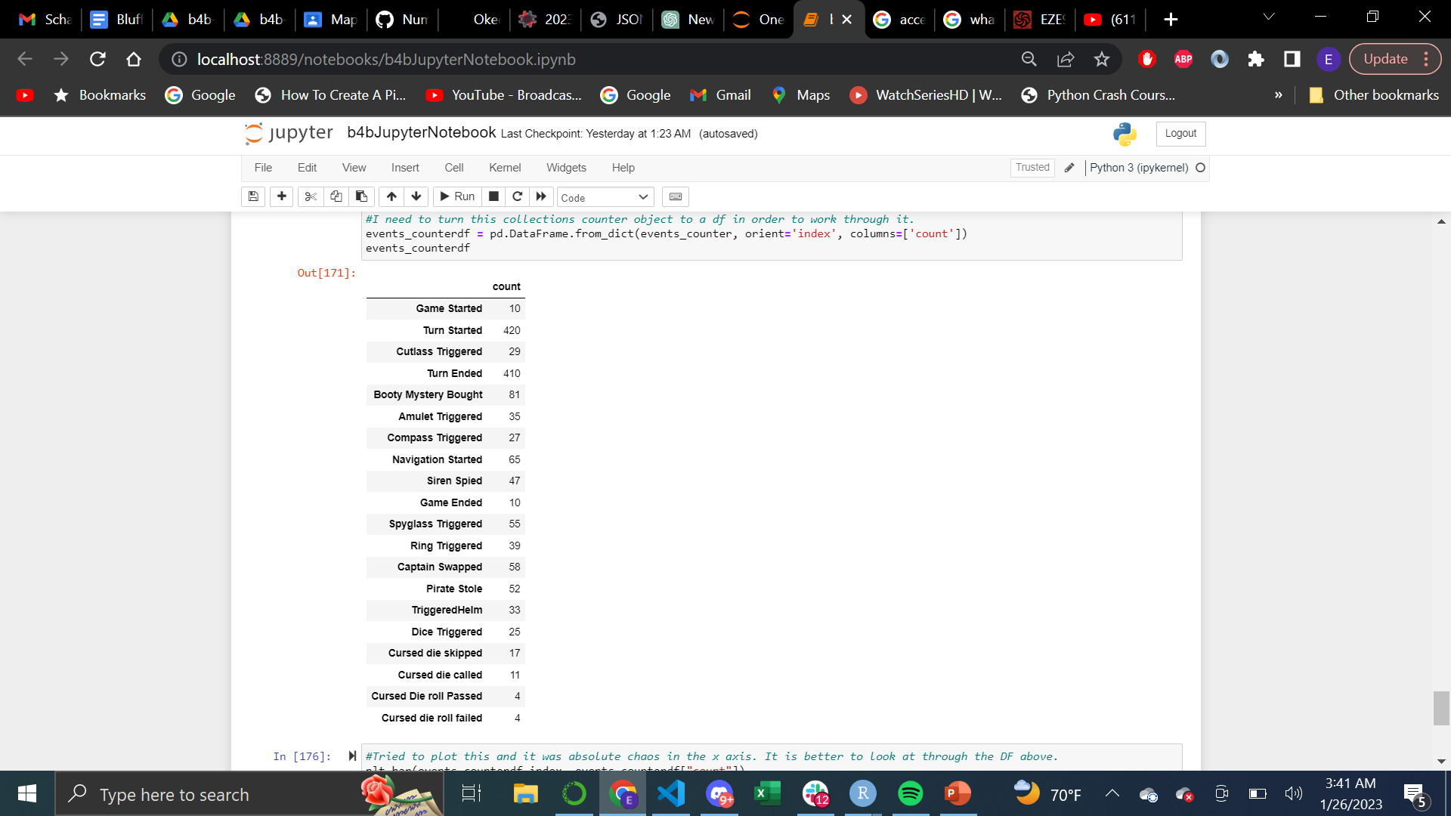
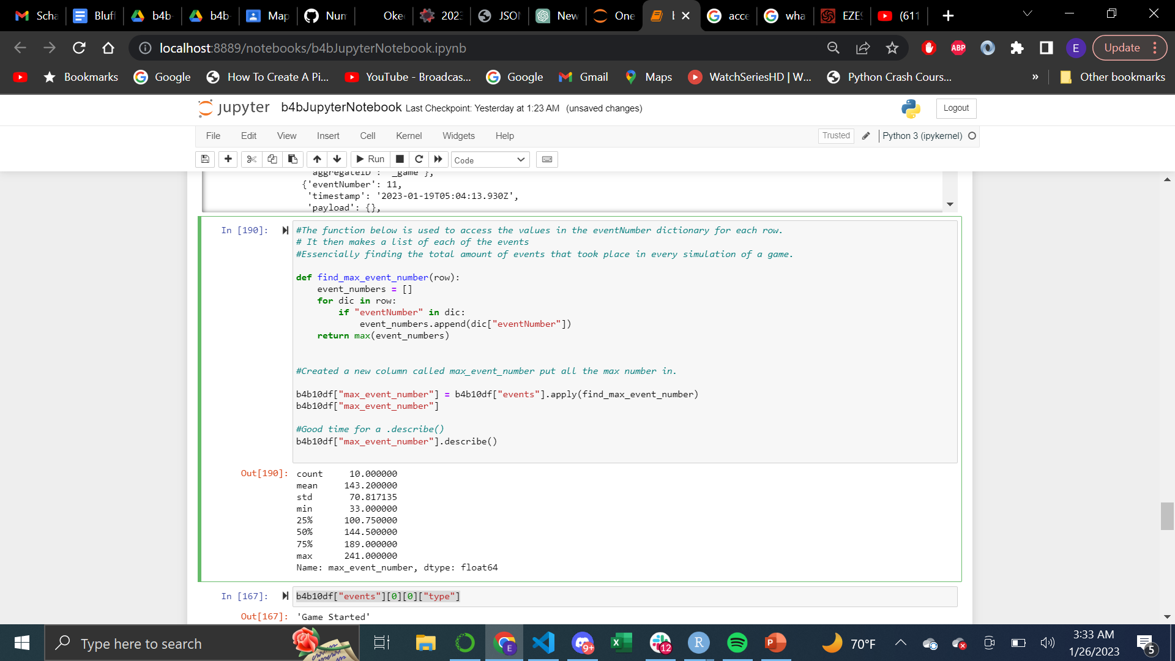
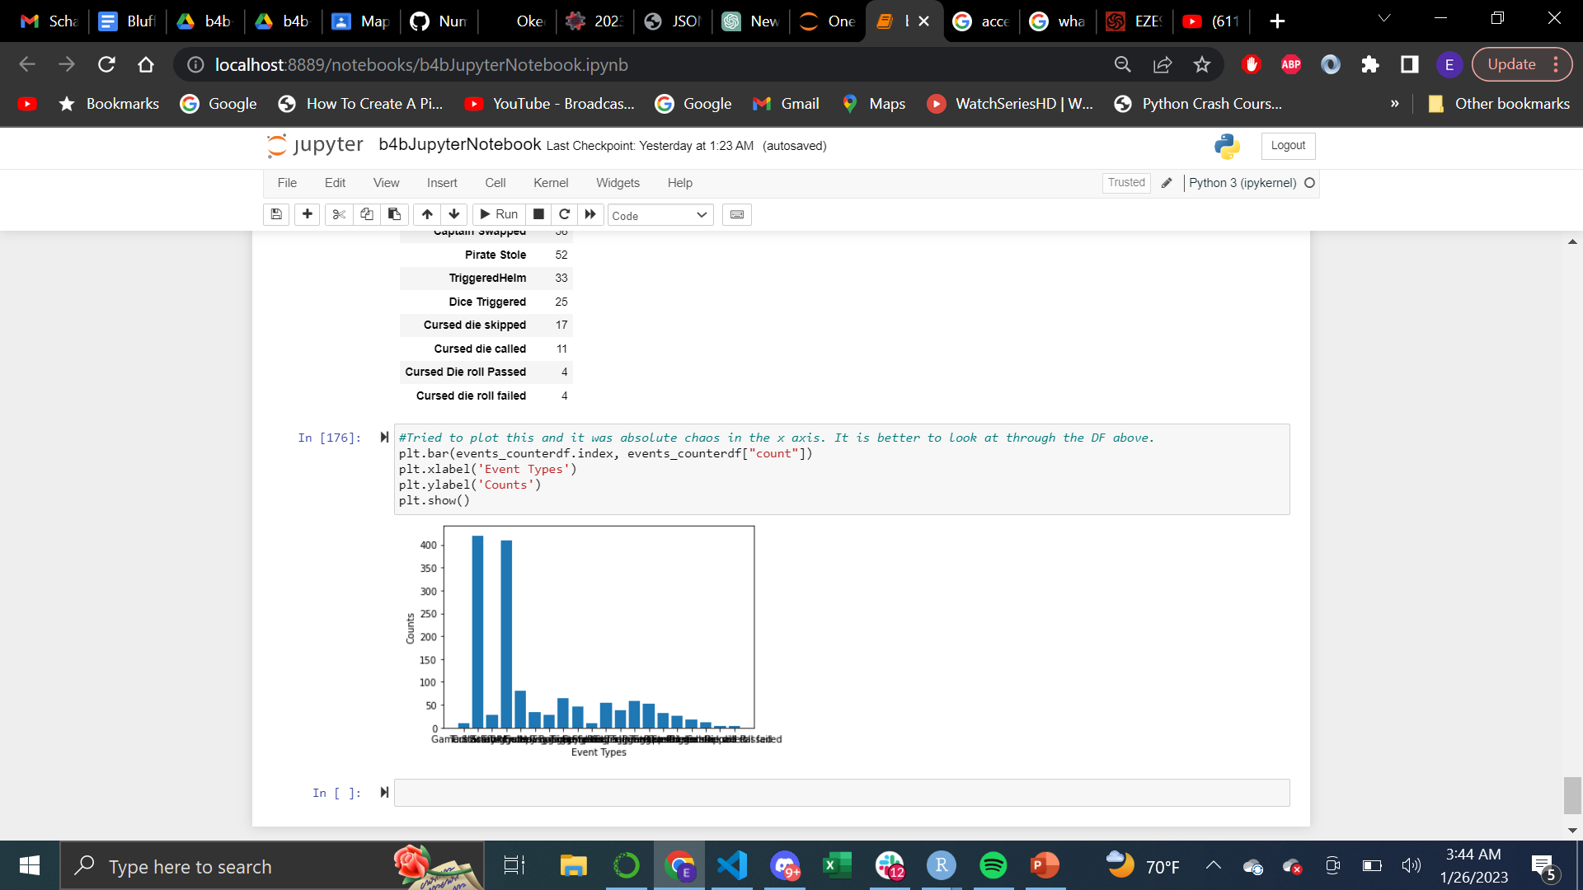
Question Answered/Code Used/Charts& Graphs
How many events on average are there per game?
This one was also fairly complicated for the same reason that there was a TON of information in a single column nested within lists within dictionaries within lists.
I had to upload a data-frame with only 10 game simulations to work on in without my computer completely crashing.
<- Output
Again, when working with these nested lists and dictionaries I found R to be much more straightforward in terms of reading the data and making the plot at the end.
Next is the R Code with the ggplot.
Pandas/Matplotlib Code Used
Output ->

Slide 15
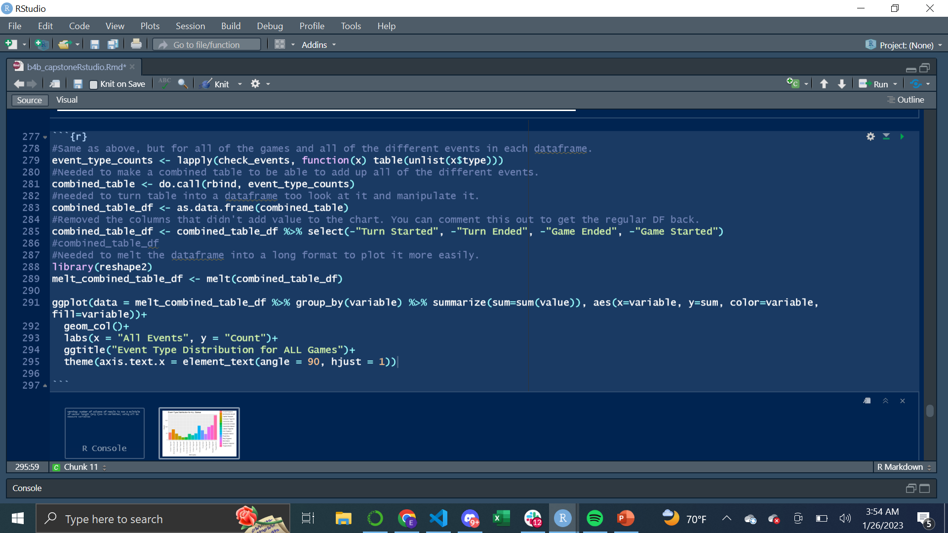
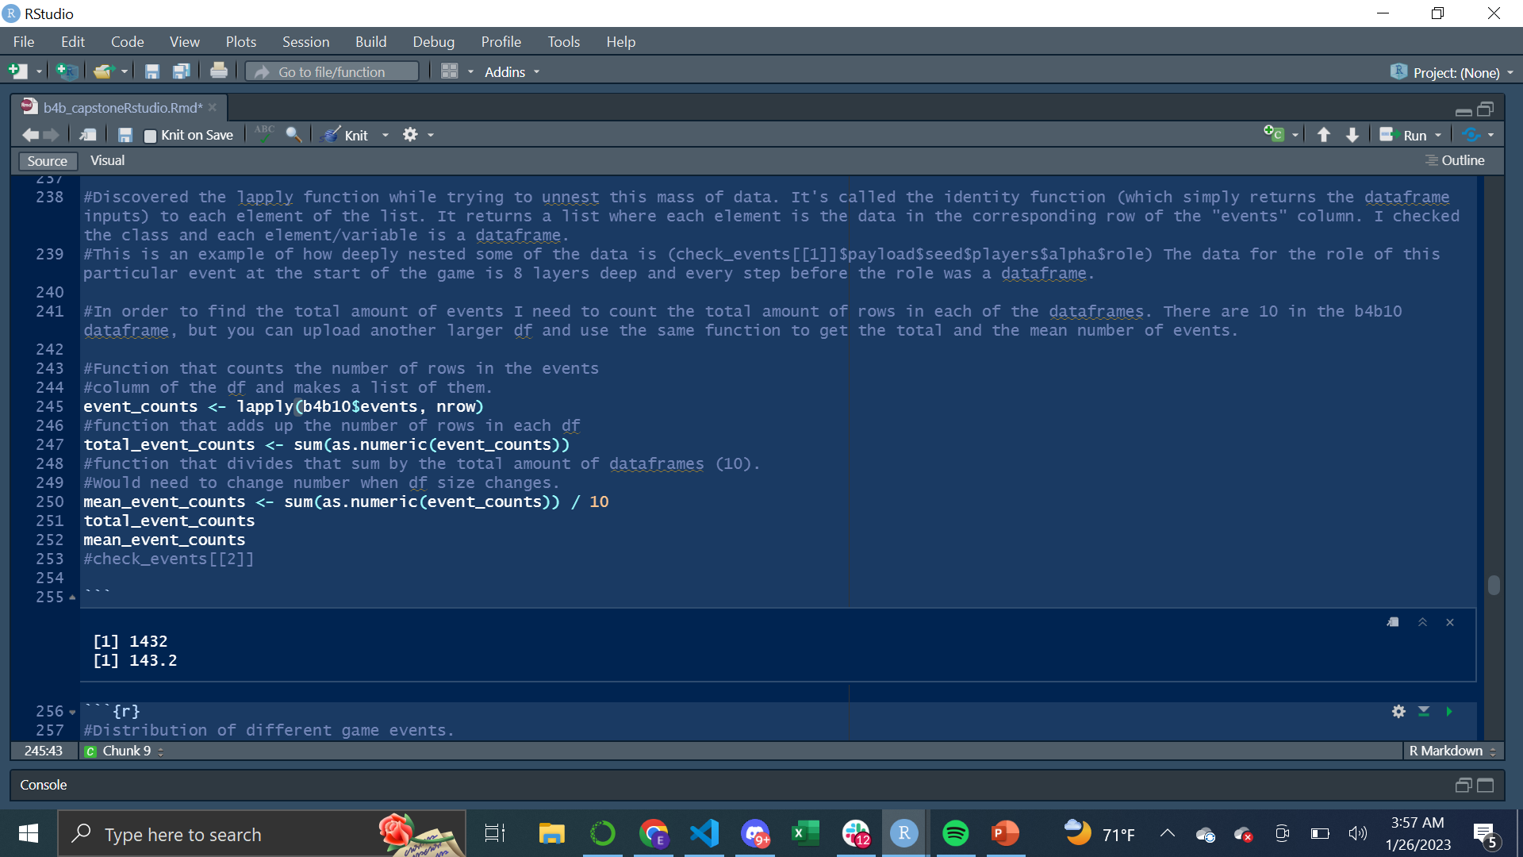
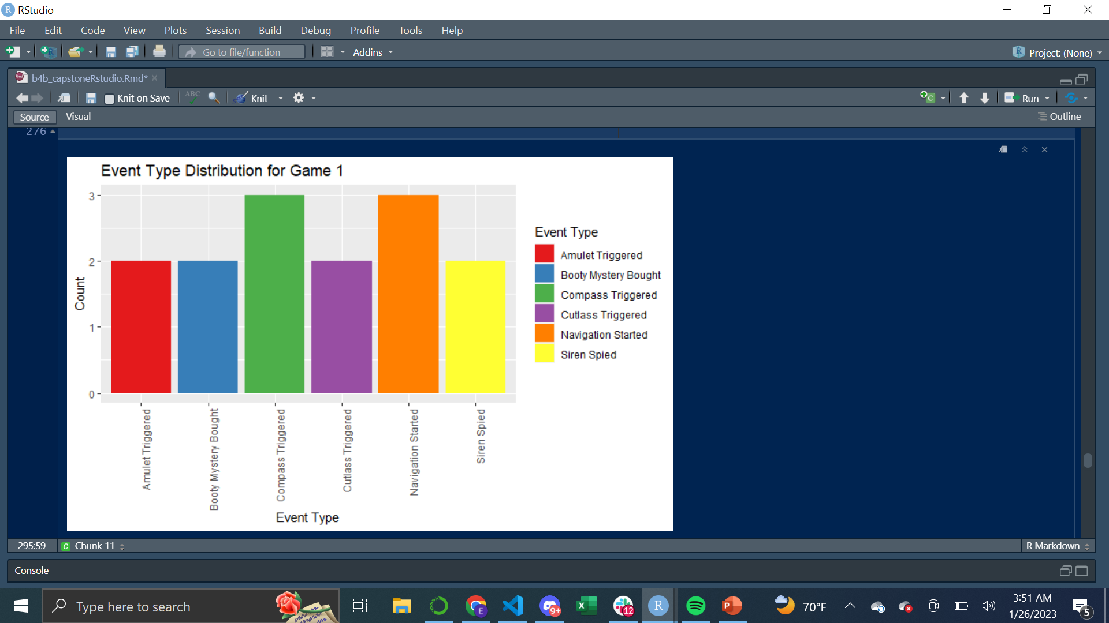
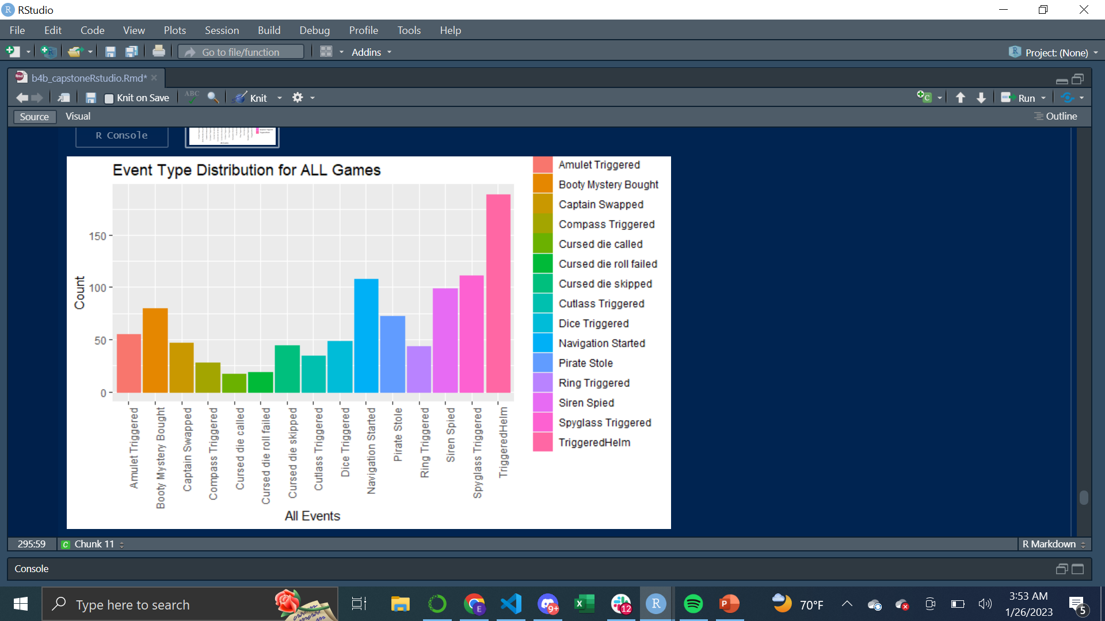
Question Answered/Code Used/Charts & Graphs
How many events on average are there per game?
What was the event type distribution for a single game compared to all the games?
R Studio Code Used
<- Output
<- Output

Slide 16
Summary
I was able to answer all the questions tasked with and now have reusable code my friend can use for future simulations of his gameplay.
This was a definitive challenge that required me to learn using a real-world example where data is not perfectly formatted and contains enormous quantities of data nested within individual cells.
The challenge was meaningful in the sense that I was able to directly help a close friend with the skills that I have developed over the course of the Coding Temple program. I am now much more comfortable and confident in moving on to bigger and more in-depth professional analysis and the development of these skills as a career.

